Slide 1
Financial Contagion and the Federal Reserve
The Upper-bound of Last-resort Loans
Thomas L. Hogan
Troy University
tlhogan@troy.edu
Linh Le
University of New Orleans
lle1@uno.edu
Malavika Nair
Troy University
mnair@troy.edu

Slide 2
Outline
Example of contagion
Financial crisis of 2008
Simulations of max lending
Conclusions

Slide 3
Contagion Example
Banks are linked by interbank assets (IBA) and interbank liabilities (IBL)
  Can include deposits, fed funds, repurchase agreements (repos), trading assets, derivatives, & swaps
Bank A |  |  |  |  |  | Bank B
Assets |  | Liabilities + Equity |  |  |  | Assets |  | Liabilities + Equity
Reserves | 10 | 20 |  | Equity |  | Reserves | 10 | 15 |  | Equity
Deposits in other banks | 5 | 20 |  | Deposits owed to banks | = | Deposits in other banks | 20 | 15 |  | Deposits owed to banks
Funds loaned to banks | 5 | 10 |  | Funds borrowed from banks | = | Funds loaned to banks | 10 | 5 |  | Funds borrowed from banks
Loans | 70 | 40 |  | Commercial deposits |  | Loans | 45 | 50 |  | Commercial deposits
Bonds | 10 | 10 |  | Other liabilities |  | Bonds | 10 | 10 |  | Other liabilities
Total | 100 | 100 |  | Total |  | Total | 95 | 95 |  | Total

Slide 4
Contagion Example
Losses on Bank A’s regular assets can make the bank illiquid → unable to pay its IBL
Bank A |  |  |  |  |  | Bank B
Assets |  | Liabilities + Equity |  |  |  | Assets |  | Liabilities + Equity
Reserves | 10 | 0 |  | Equity |  | Reserves | 10 | 15 |  | Equity
Deposits in other banks | 5 | 0 |  | Deposits owed to banks | = | Deposits in other banks | 20 | 15 |  | Deposits owed to banks
Funds loaned to banks | 5 | 0 |  | Funds borrowed from banks | = | Funds loaned to banks | 10 | 5 |  | Funds borrowed from banks
Loans | 20 | 40 |  | Commercial deposits |  | Loans | 45 | 50 |  | Commercial deposits
Bonds | 10 | 10 |  | Other liabilities |  | Bonds | 10 | 10 |  | Other liabilities
Total | 50 | 50 |  | Total |  | Total | 95 | 95 |  | Total

Slide 5
Contagion Example
Losses on Bank B’s IBA cause it to become illiquid and unable to pay its IBL
  → Contagion spreads through banking system
Bank A |  |  |  |  |  | Bank B
Assets |  | Liabilities + Equity |  |  |  | Assets |  | Liabilities + Equity
Reserves | 10 | 0 |  | Equity |  | Reserves | 10 | 0 |  | Equity
Deposits in other banks | 5 | 0 |  | Deposits owed to banks | = | Deposits in other banks | 0 | 5 |  | Deposits owed to banks
Funds loaned to banks | 5 | 0 |  | Funds borrowed from banks | = | Funds loaned to banks | 0 | 0 |  | Funds borrowed from banks
Loans | 20 | 40 |  | Commercial deposits |  | Loans | 45 | 50 |  | Commercial deposits
Bonds | 10 | 10 |  | Other liabilities |  | Bonds | 10 | 10 |  | Other liabilities
Total | 50 | 50 |  | Total |  | Total | 65 | 65 |  | Total

Slide 6
Financial Crisis of 2008
Fed bailed out non-banks in order to protect “Too-Big-To-Fail” banks.
  “JPMorgan Chase & Co. […] was one of the largest securities dealers in the world, and its problems in obtaining funding threatened to create a domino effect for other securities dealers and other markets.” – Fed (2011)

Slide 7
Financial Crisis of 2008
Fed bailed out non-banks in order to protect “Too-Big-To-Fail” banks.
  “JPMorgan Chase & Co. […] was one of the largest securities dealers in the world, and its problems in obtaining funding threatened to create a domino effect for other securities dealers and other markets.” – Fed (2011)
Estimates of actual loans:
  Low: $2.5 trillion (Bernanke 2012)
  High: $29 trillion (Felkerson 2013)

Slide 8
Fed Financial Assistance Programs
Fed commitments 2008 – 2009:
  MBS repurchase programs = $1.25 trillion
  Term asset-backed lending (TALF) = $1 trillion
  Term auction facility (TAF) = $493 billion
  Money markets (MMIFF) = $586 billion
  Commercial paper (AMLF & CPFF) = $500
  Primary dealers (PDCF) = $407 billion
  Maiden Lane purchases & loans > $200 billion
  Quantitative easing = $1.25 trillion

Slide 9
Fed Financial Assistance Programs
Fed commitments 2008 – 2009:
  MBS repurchase programs = $1.25 trillion
  Term asset-backed lending (TALF) = $1 trillion
  Term auction facility (TAF) = $493 billion
  Money markets (MMIFF) = $586 billion
  Commercial paper (AMLF & CPFF) = $500
  Primary dealers (PDCF) = $407 billion
  Maiden Lane purchases & loans > $200 billion
  Quantitative easing = $1.25 trillion
Total lending capacity > $5.75 trillion

Slide 10
Simulations of Contagion
We simulate a domino effect in the banking system to estimate required Fed loans
  Data on BHCs from September 2008
  Include off-balance-sheet activities
  No data on connections between banks
    Assume worst case to maximize Fed loans

Slide 11
Simulations of Contagion
We simulate a domino effect in the banking system to estimate required Fed loans
  Data on BHCs from September 2008
  Include off-balance-sheet activities
  No data on connections between banks
    Assume worst case to maximize Fed loans
Simulate 3 domino effects:
  Failure of largest bank
  Assets shock
  Largest bank + asset shock

Slide 12
Large-bank Simulation
Largest BHC (by interbank liabilities) fails
Other BHCs sorted by equity / IBA

Slide 13
Large-bank Simulation
Largest BHC (by interbank liabilities) fails
Other BHCs sorted by equity / IBA
Banks fail in order 1-by-1
  IBL of large bank reduce IBA of 2nd largest and so on
  Equity of each BHC depletes contagion in IBL
  Continues until IBA losses are too small to cause failure

Slide 14
Large-bank Simulation
Largest BHC (by interbank liabilities) fails
Other BHCs sorted by equity / IBA
Banks fail in order 1-by-1
  IBL of large bank reduce IBA of 2nd largest and so on
  Equity of each BHC depletes contagion in IBL
  Continues until IBA losses are too small to cause failure
Fed lends to all illiquid BHCs
  Does not lend to largest BHC

Slide 15
Large-bank Simulation
Are off-balance-sheet activities IBA or regular bank assets?
  We calculate both scenarios

Slide 16
Large-bank Simulation
Are off-balance-sheet activities IBA or regular bank assets?
  We calculate both scenarios
    Basic IBA = Interbank deposits + Fed funds + repos
Illiquid assets | Illiquid banks | Fed Loans
2.7% | 3.6% | $2.6 trillion

Slide 17
Large-bank Simulation
Are off-balance-sheet activities IBA or regular bank assets?
  We calculate both scenarios
    Basic IBA = Interbank deposits + Fed funds + repos
    Max IBA = Basic + trading assets + CDS + derivatives
Illiquid assets | Illiquid banks | Fed Loans
2.7% | 3.6% | $2.6 trillion
Illiquid assets | Illiquid banks | Fed Loans
20.2% | 4.9% | $4.6 trillion

Slide 18
Asset Shock Simulation
All BHCs sorted by equity / IBA
Shock reduces asset values of all banks
Some BHCs fail. IBL losses create contagion.

Slide 19
Asset Shock Simulation
All BHCs sorted by equity / IBA
Shock reduces asset values of all banks
Some BHCs fail. IBL losses create contagion.
Banks fail in order 1-by-1
  IBL of large bank reduce IBA of 2nd largest and so on
  Equity of each BHC depletes contagion in IBL
  Continues until IBA losses are too small to cause failure

Slide 20
Asset Shock Simulation
All BHCs sorted by equity / IBA
Shock reduces asset values of all banks
Some BHCs fail. IBL losses create contagion.
Banks fail in order 1-by-1
  IBL of large bank reduce IBA of 2nd largest and so on
  Equity of each BHC depletes contagion in IBL
  Continues until IBA losses are too small to cause failure
Fed lends to all illiquid BHCs

Slide 21
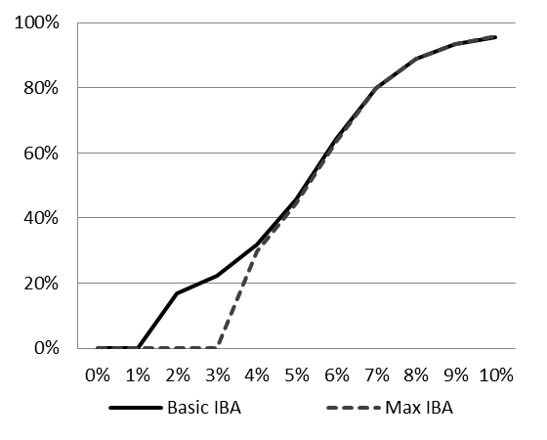
Illiquid Banks
Shock to bank assets

Slide 22
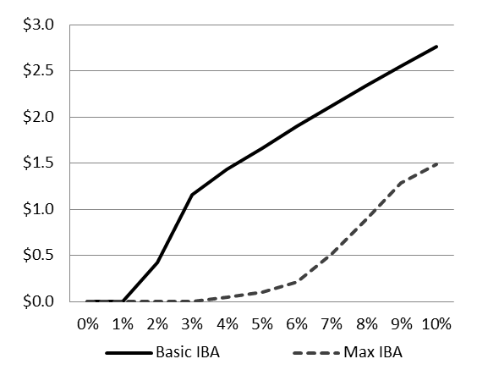
Fed Loans
Shock to bank assets

Slide 23
Large-bank + Asset Shock
Largest BHC fails + shock to all banks’ assets
Other BHCs sorted by equity / IBA

Slide 24
Large-bank + Asset Shock
Largest BHC fails + shock to all banks’ assets
Other BHCs sorted by equity / IBA
Banks fail in order 1-by-1
  IBL of large bank reduce IBA of 2nd largest and so on
  Equity of each BHC depletes contagion in IBL
  Continues until IBA losses are too small to cause failure

Slide 25
Large-bank + Asset Shock
Largest BHC fails + shock to all banks’ assets
Other BHCs sorted by equity / IBA
Banks fail in order 1-by-1
  IBL of large bank reduce IBA of 2nd largest and so on
  Equity of each BHC depletes contagion in IBL
  Continues until IBA losses are too small to cause failure
Fed lends to all illiquid BHCs
  Does not lend to largest BHC

Slide 26
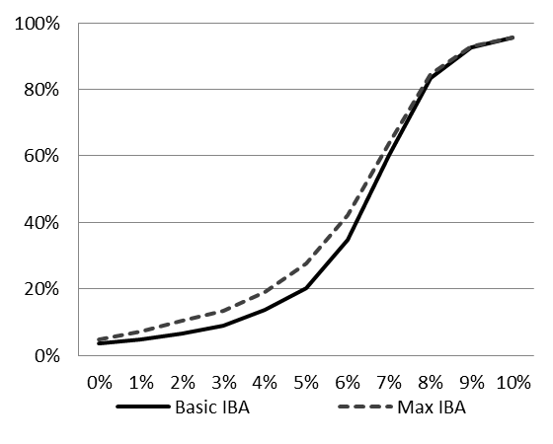
Illiquid Banks
Shock to bank assets

Slide 27
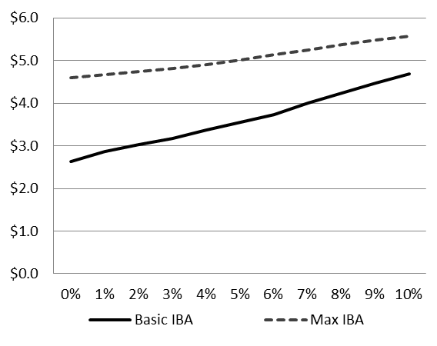
Fed Loans
Shock to bank assets

Slide 28
Conclusions
Fear of contagion caused Fed to bail out non-banks rather than only commercial banks
  Committed at least $5.75 trillion

Slide 29
Conclusions
Fear of contagion caused Fed to bail out non-banks rather than only banks
  Committed at least $5.75 trillion
We (over)estimate required Fed loans
  Simulate asset shocks & domino effects
  Max loan amounts range from $1.5 to $5.6 trillion

Slide 30
Conclusions
Fear of contagion caused Fed to bail out non-banks rather than only banks
  Committed at least $5.75 trillion
We (over)estimate required Fed loans
  Simulate asset shocks & domino effects
  Max loan amounts range from $1.5 to $5.6 trillion
The Fed would have spent less if it had lent to only banks rather than non-banks

