Slide 1
Austrian Business Cycle Theory: Time is Not of the Essence
William J. Luther
J.P. McElyea

Slide 2
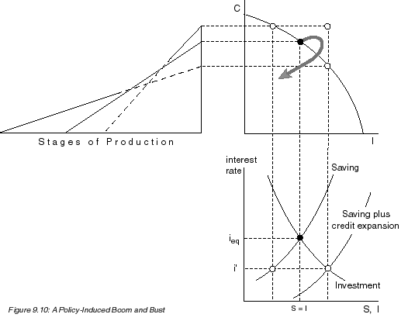

Slide 3
Empirical Analysis
Lack of Empirical Relevance
Lester and Wolff (2013)
Luther and Cohen (2014a)
Lack of Data to Consider Empirical Relevance
Luther and Cohen (2014b)

Slide 4
Objectives:
Re-state Austrian Business Cycle Theory in such a way that is consistent with the historical view but is not subject to the empirical criticism(s) discussed above.
Demonstrate that modified Austrian Business Cycle Theory yields interesting aggregate implications
Note that, to the extent that these implications are not unique, they have much common ground with some Keynesian ideas that Austrians usually reject out of hand

Slide 5
Necessary Components
Boom
Monetary misperceptions
Overproduction
Malinvestment
Bust
Expectations adjustment
Resource reallocation
Underproduction (relative to former potential)

Slide 6
Simple Model
Central Bank:
Targets level of nominal income consistent with given growth rate
Producers:
Wish to produce level of real output consistent with given growth rate
Understand CB strategy, but face signal extraction problem

Slide 7
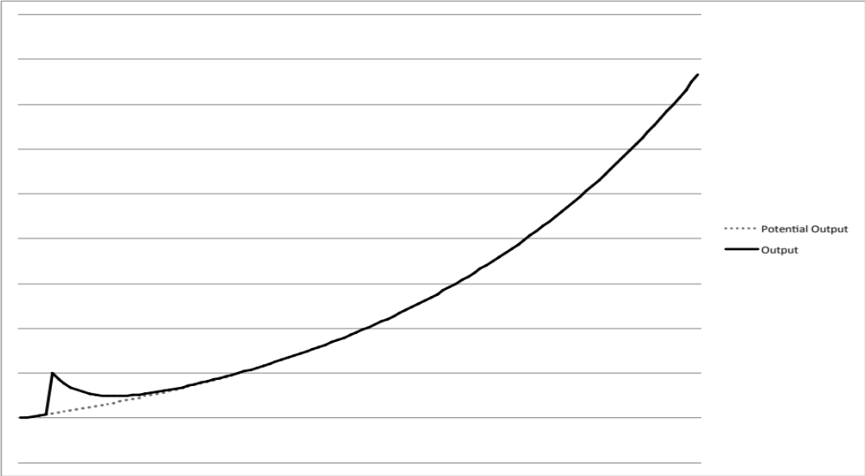
Benchmark Model:
Positive Monetary Shock

Slide 8
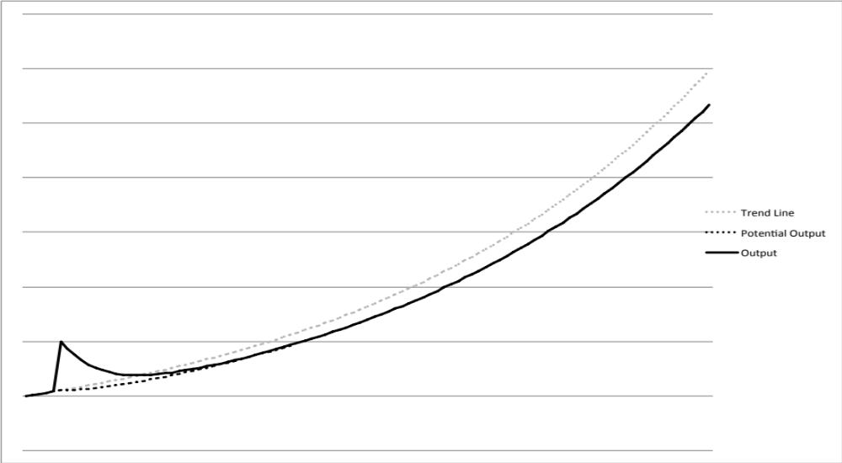
Austrian Model:
Positive Monetary Shock

Slide 9
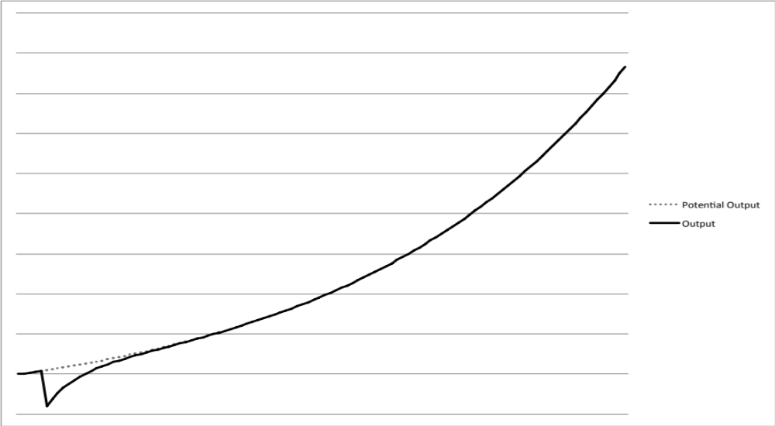
Benchmark Model:
Negative Monetary Shock

Slide 10
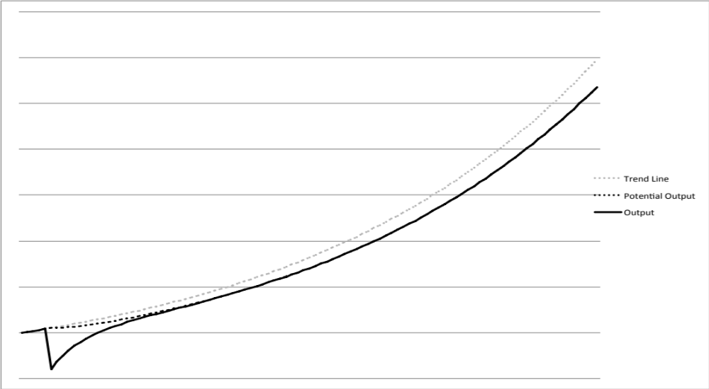
Austrian Model:
Negative Monetary Shock

Slide 11
Reallocation Costs
Physical capital
Revalue
Retool
Relocate
Human capital
Revalue
Reeducate
Relocate

